Slide 1
Team project

Slide 2
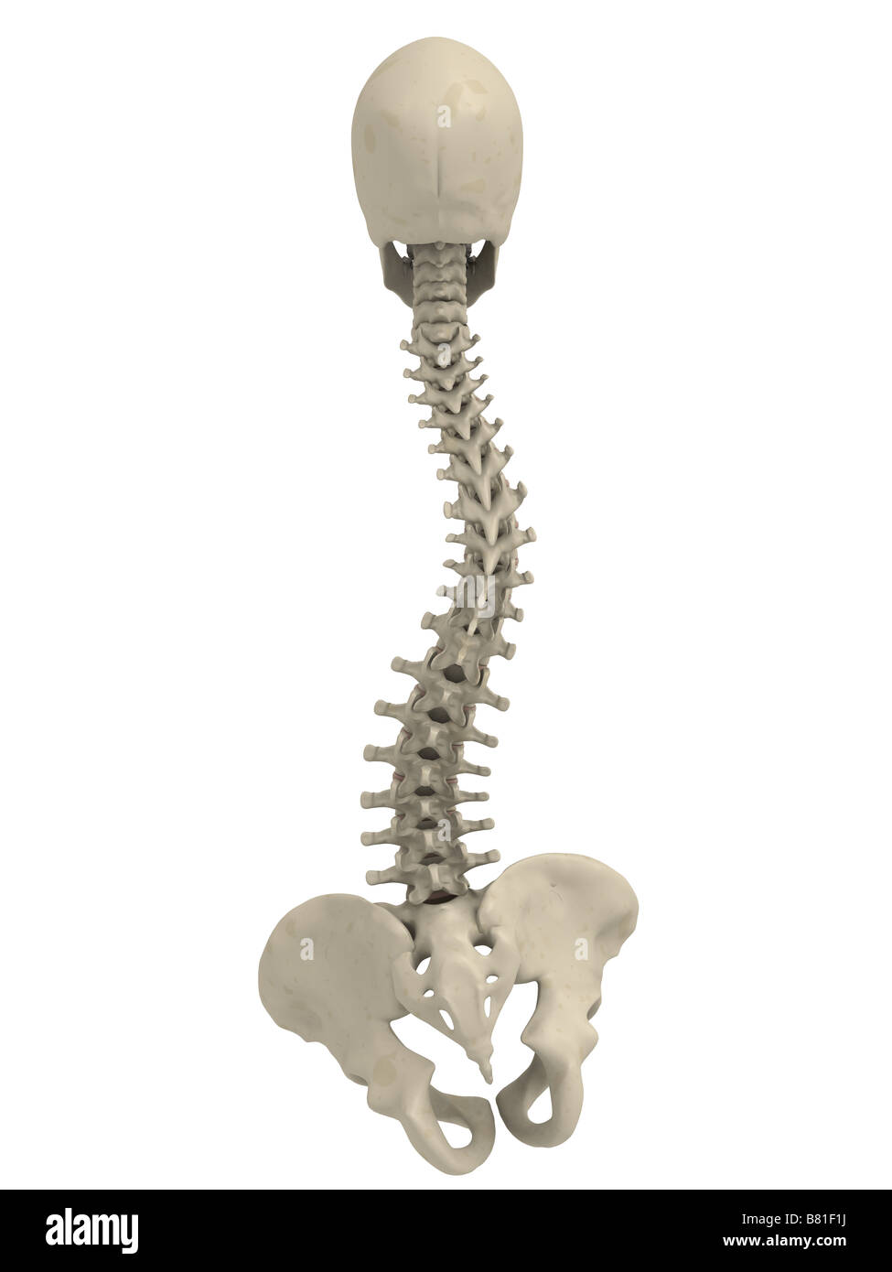
Problem 1: Scoliosis
According to the American Academy of Neurological Surgeons, scoliosis affects approximately six to nine million people in the United States, accounting for about 2-3 percent of the population (AANS).
Furthermore, the primary age of onset for scoliosis, according to the same source, is 10-15 years old, and it affects both genders equally.
=> Solution: use ergonomic chairs to fix user’s posture

Slide 3

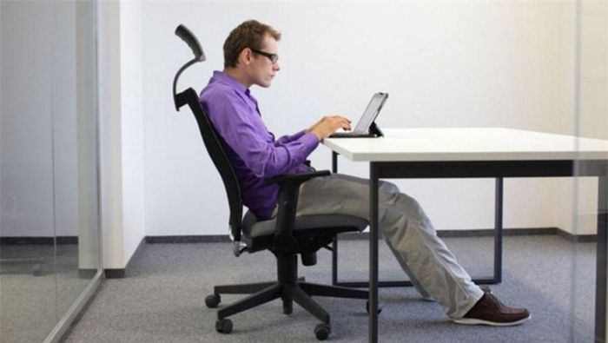
Problem 2: Current ergonomic chairs are lacking
Since users are not fully aware of the different features and adjustments, they do not use the chair in an optimal ergonomic way. => Too user-dependent
Meantime, users have no clue about the postures that he or she adopted without being given explicit feedback and instruction.
=>Users go back to wrong sitting posture on different chair.

Slide 4
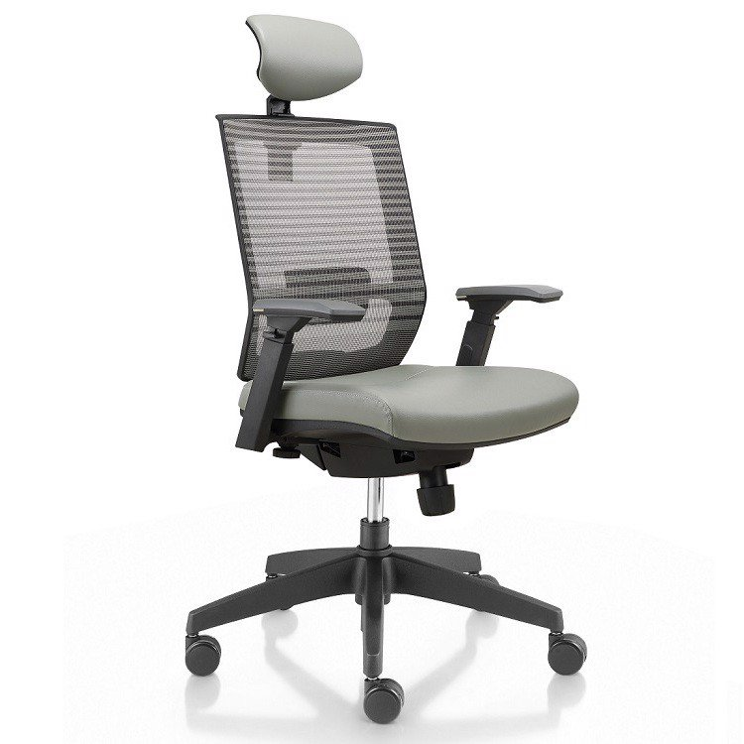


Solution
Combine the pre-existing ergonomic chair design with all its features for correcting posture
with the analytic power of Artificial Intelligent to automatically adjust the chair base on information recorded when the user sit to give the user a comfortable and healthy experience while giving feedback and advice to user to improve their sitting posture in the future.
+ =

